Slide 1
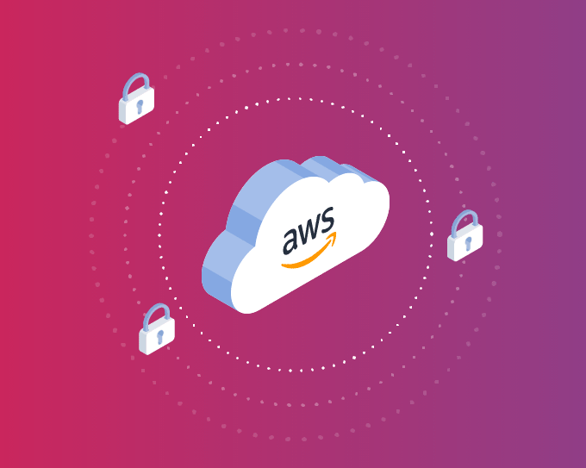
Security Incident Event Monitoring using AWS
By: Sushant Burde
Monish Phatarpekar
Maitri Shah
Siddhi Udani

Slide 2
What are we doing here?
1) When Amazon finds some security incidents, the findings are put into the GuardDuty Dashboard.
2) These incidents are reported to the security monitoring teams notification channel or an email address.
3) Use CloudWatch events to push those findings which In turn would trigger our Lambda function.
4) Lastly, these events would then be sent to a SNS topic used by security monitoring teams.

Slide 3
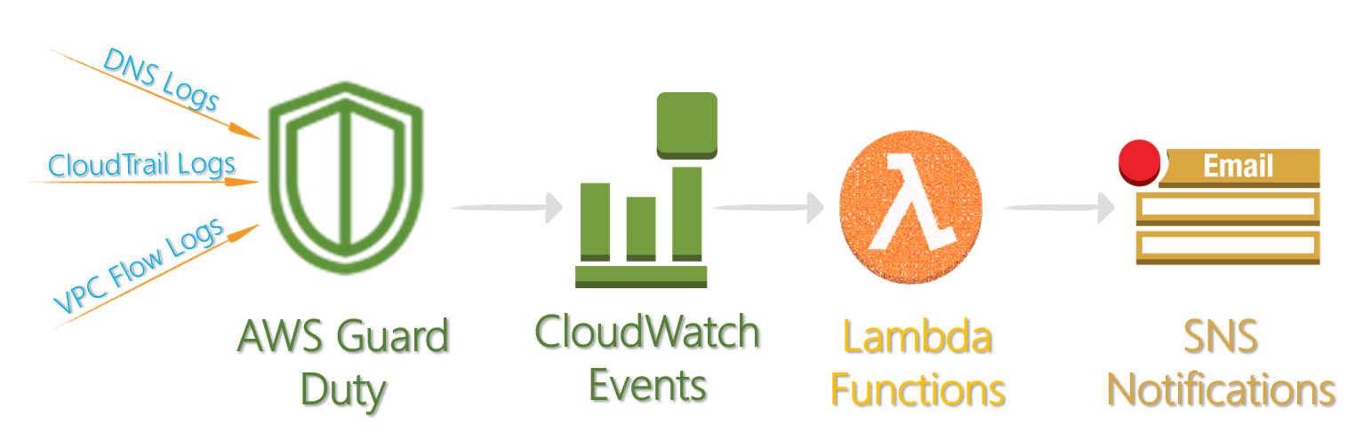
Workflow

Slide 4

AWS GuardDuty:
Amazon GuardDuty is a managed cloud security monitoring service that continuously monitors threats, malicious activity and unauthorized behavior that can compromise your AWS accounts, resources or workloads.
It operates completely independently from your resources so there is no risk of performance or availability impacts to your workloads
With GuardDuty, you now have an intelligent and cost-effective option for continuous threat detection in the AWS Cloud.
The service uses machine learning, anomaly detection, and integrated threat intelligence to identify and prioritize potential threats.

Slide 5
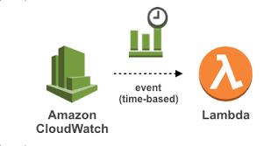
CloudWatch Events:
Amazon CloudWatch Events delivers a near real-time stream of system events that describe changes in Amazon Web Services (AWS) resources.
Using simple rules that you can quickly set up, you can match events and route them to one or more target functions or streams.
It integrates with AWS identity and Access Management (IAM) so that you can specify which CloudWatch actions a user in your AWS account can perform
CloudWatch Events responds to these operational changes and takes corrective action as necessary, by sending messages to respond to the environment, activating functions, making changes, and capturing state information.

Slide 6
Lambda Functions:
Lambda functions are essentially blocks of code that can be assigned to variables, passed as an argument, or returned from a function call, in languages that support high-order functions.
With lambda, you can run code virtually for any type of application
You can set up your code to automatically trigger from other AWS services or call it directly from any web or mobile app.

Slide 7
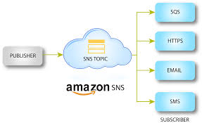
SNS Notification:
Amazon Simple Notification Service (SNS) is a notification service provided as part of Amazon Web Services since 2010.
Its very easy to get started where you have to create the access point which is called as topic- identifying a specific event for publishing messages to subscribe for notifications.
From the sender's viewpoint, SNS acts as a single message bus that can message to a variety of devices and platforms, from the Kindle Fire to Baidu. A single code interface can address all of these equally, or message formats can be tailored to the particular needs of each platform.
SNS can also deliver messages by SMS to 200+ countries.
SNS uses the publish/subscribe model for push delivery of messages

Slide 8
Pre-Requisities:
We had two pre-requisites to be executed in order to successfully complete this monitoring activity.
The two pre-requisities are:
SNS Topic.
IAM Role:

Slide 9
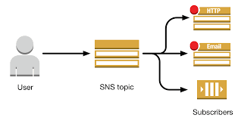
SNS Topic:
An Amazon SNS topic is a logical access point that acts as a communication channel. A topic lets you group multiple endpoints (such as AWS Lambda, Amazon SQS, HTTP/S, or an email address).

Slide 10
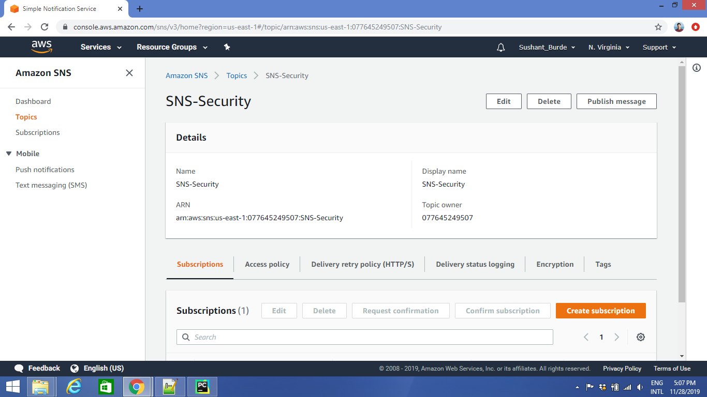
SNS Topic:
Here we have created a SNS topic which is an unique ARN (Amazon Resource Names).
Amazon Resource Names uniquely identify AWS resources.
We require an ARN when you need to specify a resource unambiguously across all of AWS, such as in IAM policies, Amazon Relational Database Service (Amazon RDS) tags, and API calls. Contents. ARN Format.

Slide 11
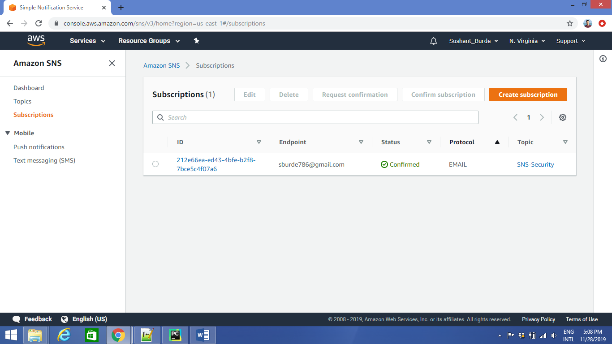
SNS Subscription:
Since we have created a SNS topic, now we have to give a destination Email address which we need to subscribe with our SNS topic.
Once the Email address is subscribed we get the monitoring results on this specific address.

Slide 12
IAM Role:
An IAM role is an IAM entity that defines a set of permissions for making AWS service requests.
IAM roles are not associated with a specific user or group. Instead, trusted entities assume roles, such as IAM users, applications, or AWS services such as EC2.

Slide 13
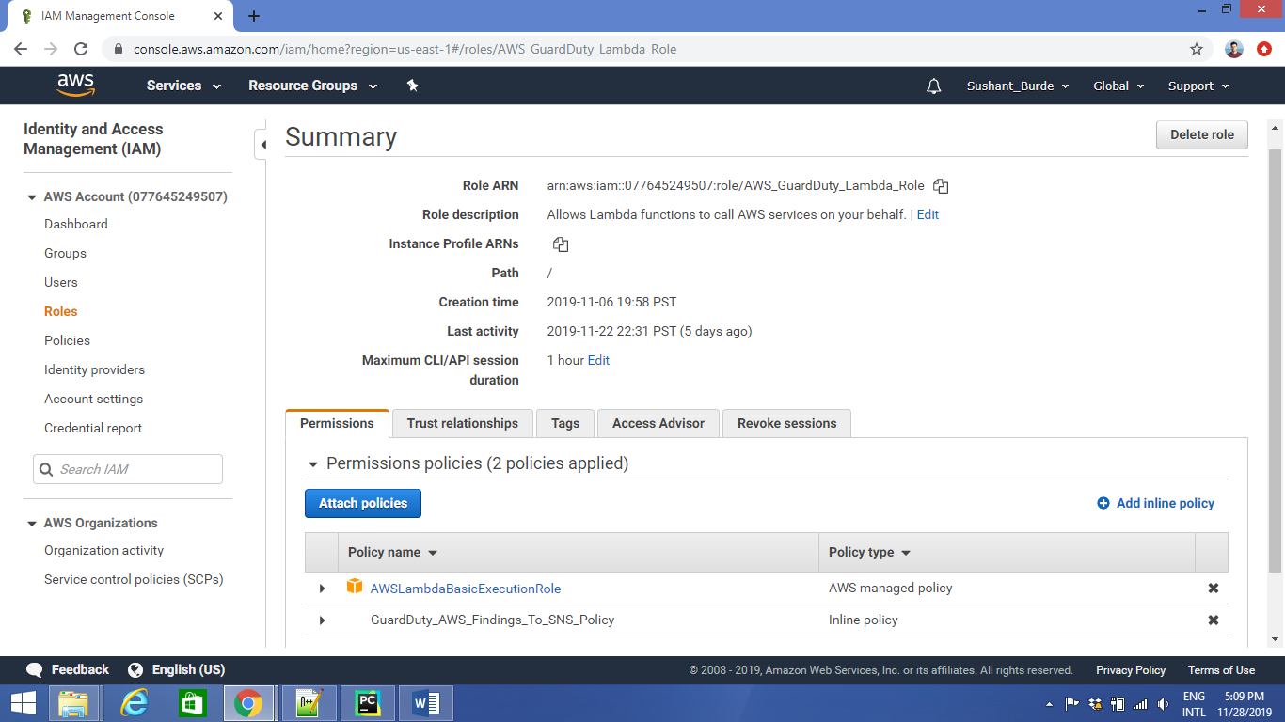
IAM Service Created:
We have created a Lambda Service Role that will have full EC2 permissions that can be assumed by Lambda functions to trigger Snapshots or reboot servers, etc.

Slide 14
IAM Policy:
A policy is an entity that, when attached to an identity or resource, defines their permissions.
Policies are stored in AWS as JSON documents and are attached to principals as identity-based policies in IAM.
You can attach an identity-based policy to a principal (or identity), such as an IAM group, user, or role.

Slide 15
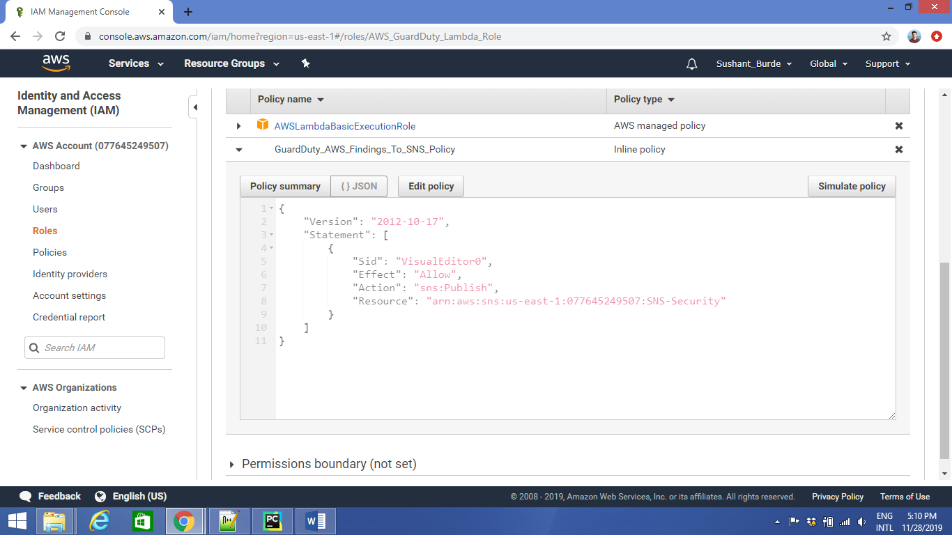
SNS ARN attached to IAM In line policy:

Slide 16
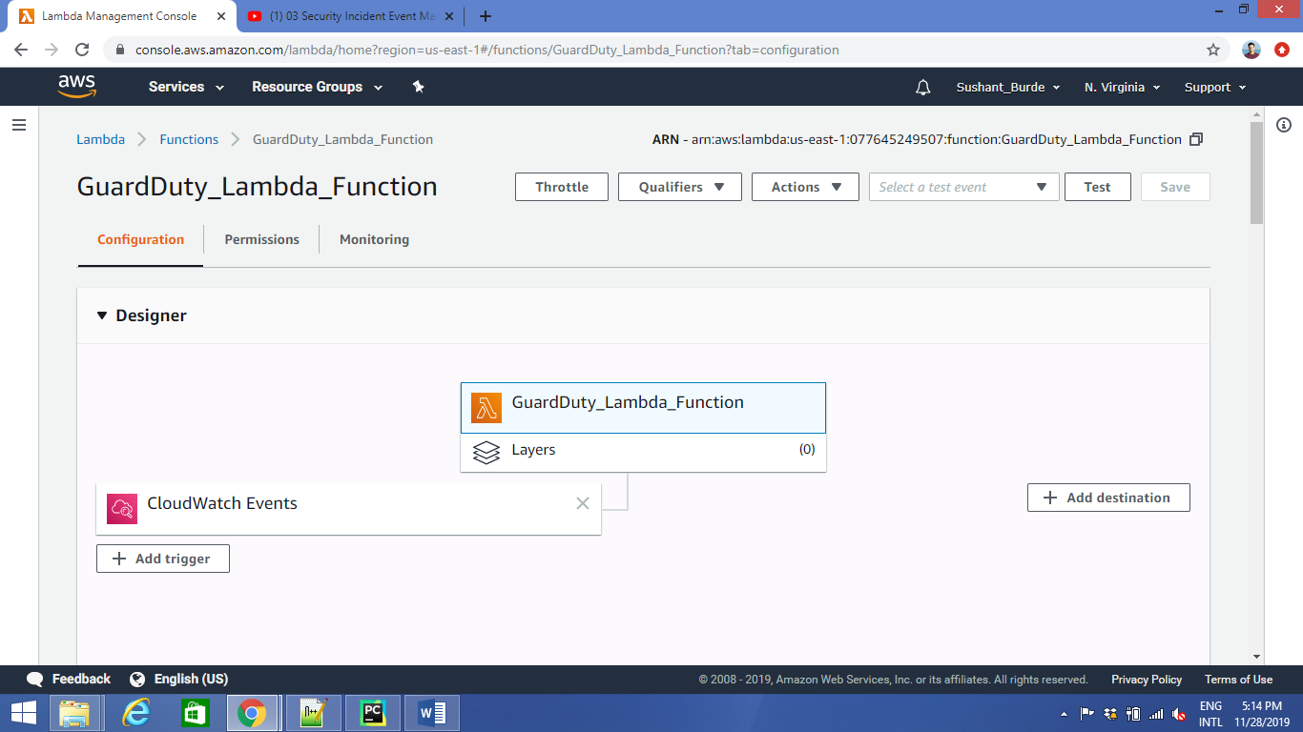
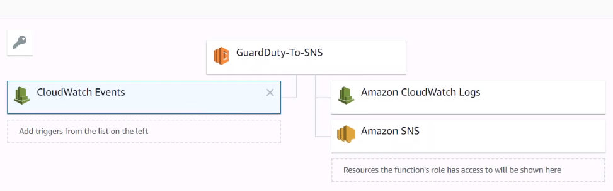
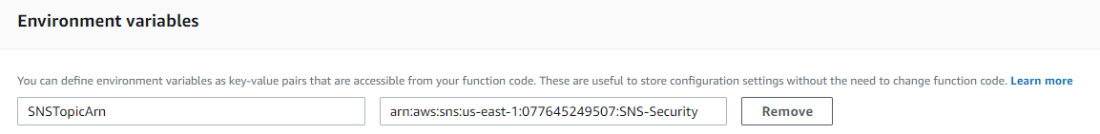
Lambda Function:
We have linked Cloudwatch events, AWS logs and Amazon SNS to Guardduty to generate the Lambda function.
The Amazon SNS is linked to the GuardDuty using a Global variable.

Slide 17
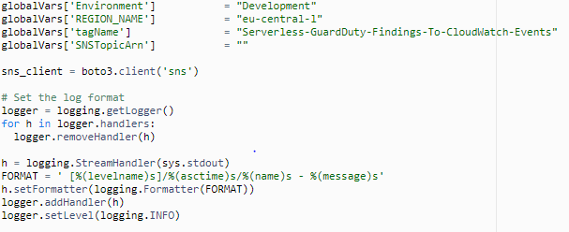
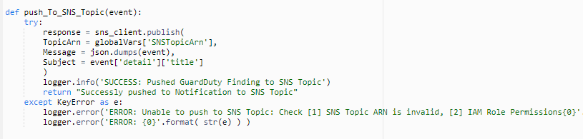
Python code inside Lambda Function:
We are executing a python try and error code.
In this code we are publishing topic ARN, messages and subjects to the subscriber.
If its successfully executed, the subscriber gets a notification or if there is any error it will go back to the key error and will give a message stating the error.

Slide 18
Rules for AWS CloudWatch:
In CloudWatch Events, it is possible to create rules that lead to infinite loops, where a rule is fired repeatedly. For example, a rule might detect that ACLs have changed on an S3 bucket, and trigger software to change them to the desired state. If the rule is not written carefully, the subsequent change to the ACLs fires the rule again, creating an infinite loop.
To prevent this, write the rules so that the triggered actions do not re-fire the same rule. For example, your rule could fire only if ACLs are found to be in a bad state, instead of after any change.
An infinite loop can quickly cause higher than expected charges.

Slide 19
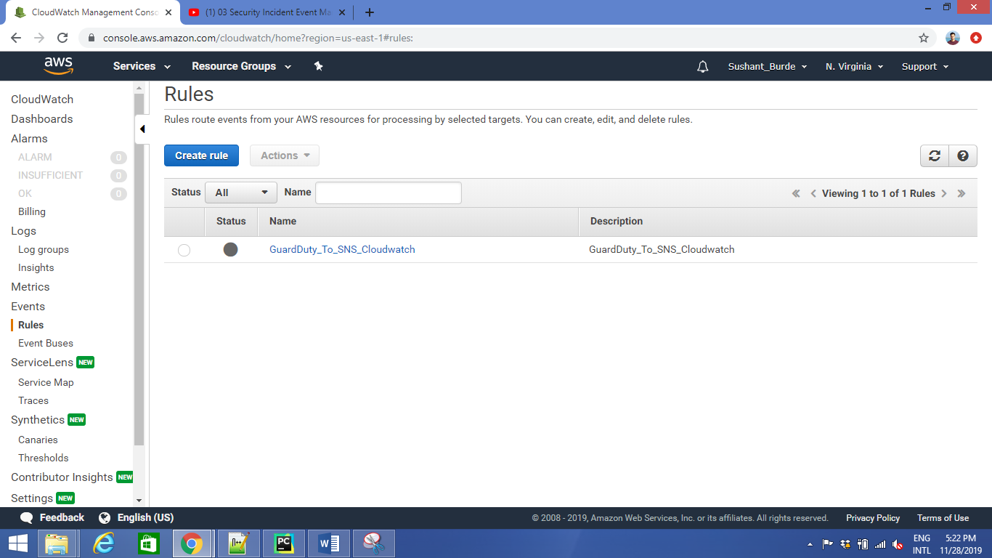
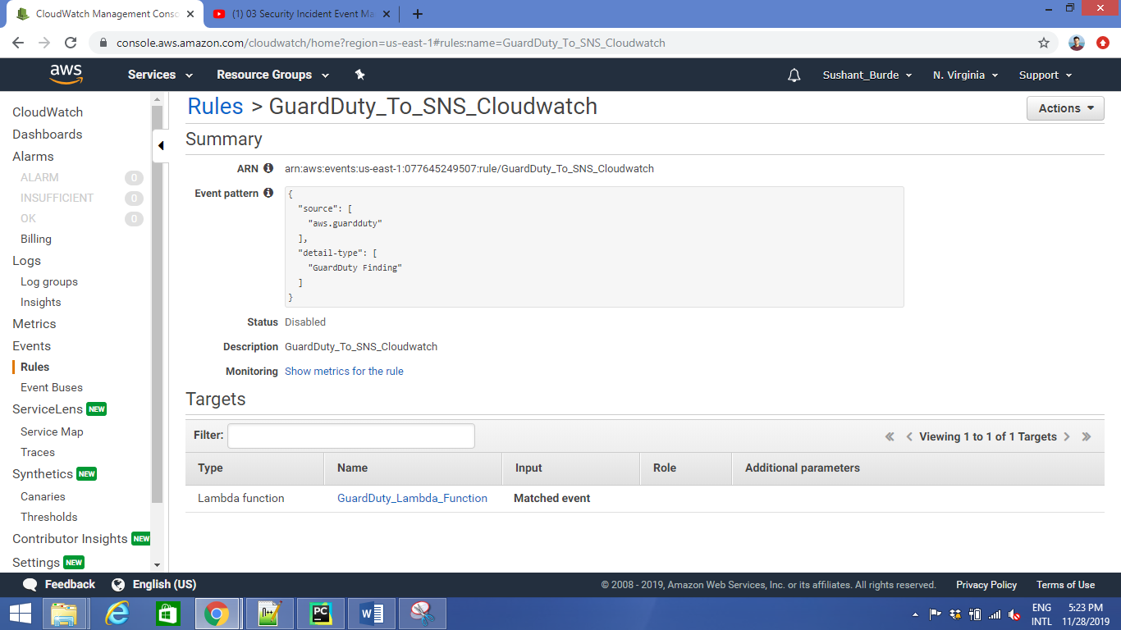
Creating a rule for AWS Cloudwatch:
We have created a AWS cloud watch rule and enabled it for sending email notifications.
AWS CloudWatch rule should be linked with lambda function in order to receive notification via SNS topic.

Slide 20
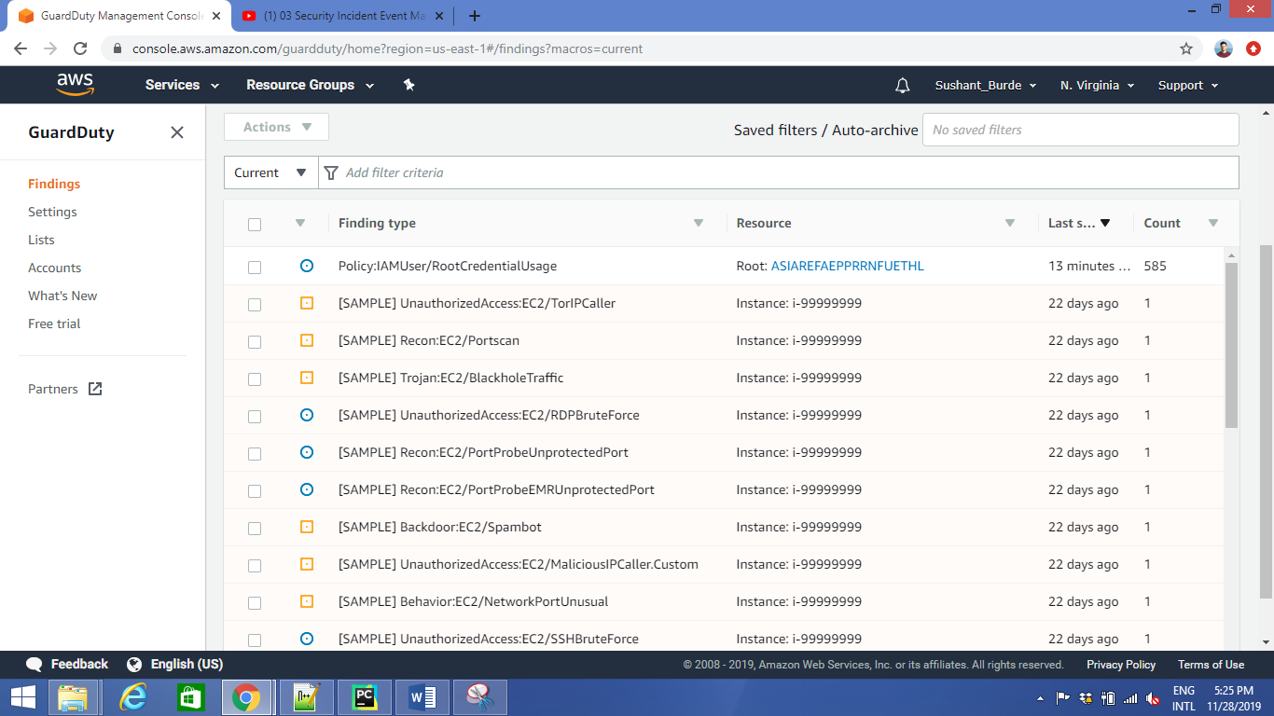
GuardDuty sample Incident findings:
These are some sample incidents findings generated by the GuardDuty.
Sample findings can help you visualize and analyze the various finding types that GuardDuty generates.
When you generate sample findings, GuardDuty populates your current findings list with one sample finding for each supported finding type.

Slide 21
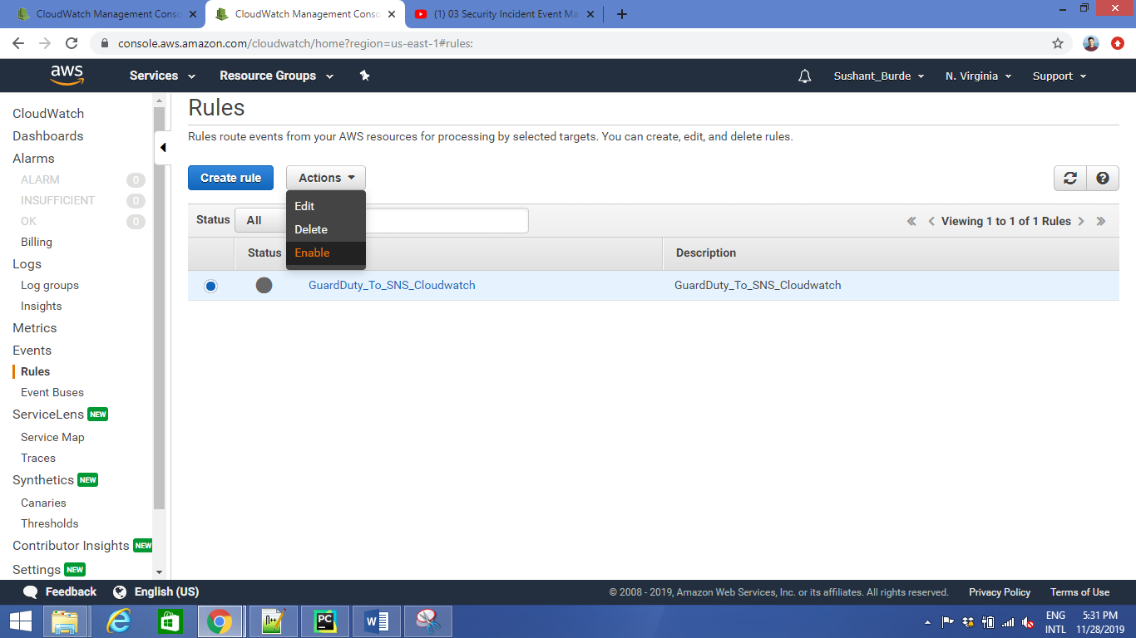
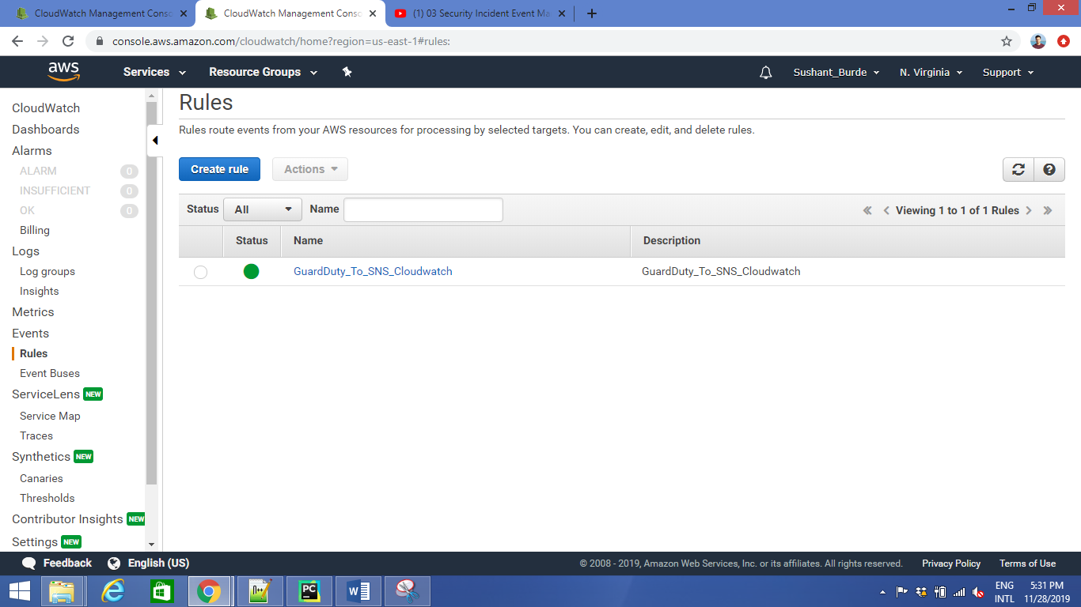
Activating Rule for AWS cloudwatch:
Here we are Activating the rule which we created for AWS Cloudwatch.
Enables the specified rule. If the rule doesn't exist, the operation fails.
When you enable a rule, incoming events might not immediately start matching to a newly enabled rule. Allow a short period of time for changes to take effect.

Slide 22
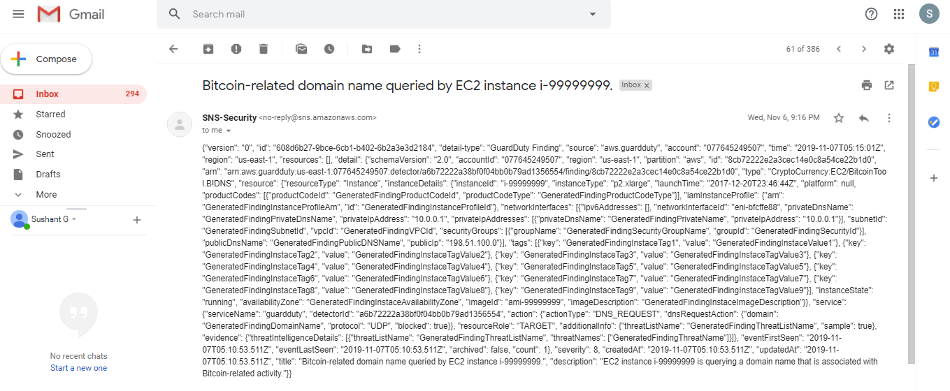
Results:
For example: There was an issue with Bitcoin-related domain on EC2.
So we will get notifications like
"version": "0",
"id": "608d6b27-9bce-6cb1-b402-6b2a3e3d2184",
"detail-type": "GuardDuty Finding",
"source": "aws.guardduty", "account": "077645249507",
"time": "2019-11-07T05:15:01Z",
"privateIpAddress": "10.0.0.1",
"severity": 8,
"createdAt": "2019-11-07T05:10:53.511Z",
"updatedAt": "2019-11-07T05:10:53.511Z",
"title": "Bitcoin-related domain name queried by EC2 instance i-99999999.", "description": "EC2 instance i-99999999 is querying a domain name that is associated with Bitcoin-related activity."

Slide 23
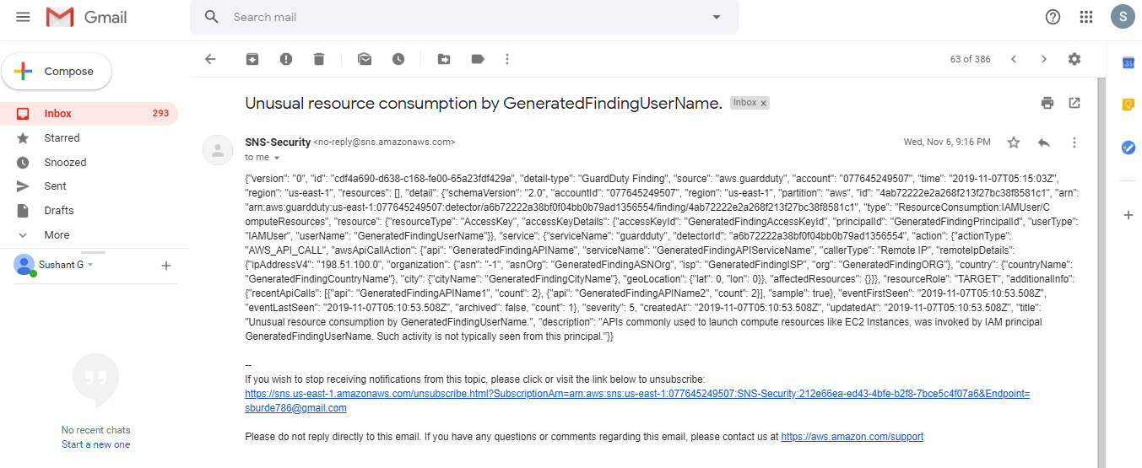
Another example:

Slide 24
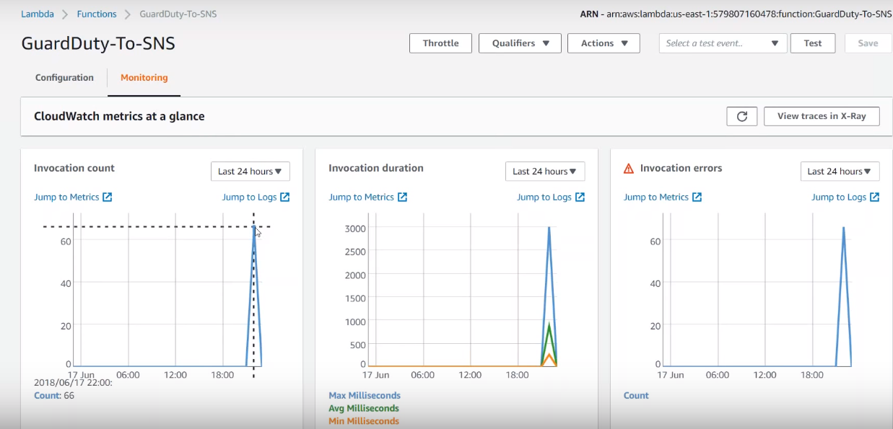
You can monitor logs as well:

Slide 25
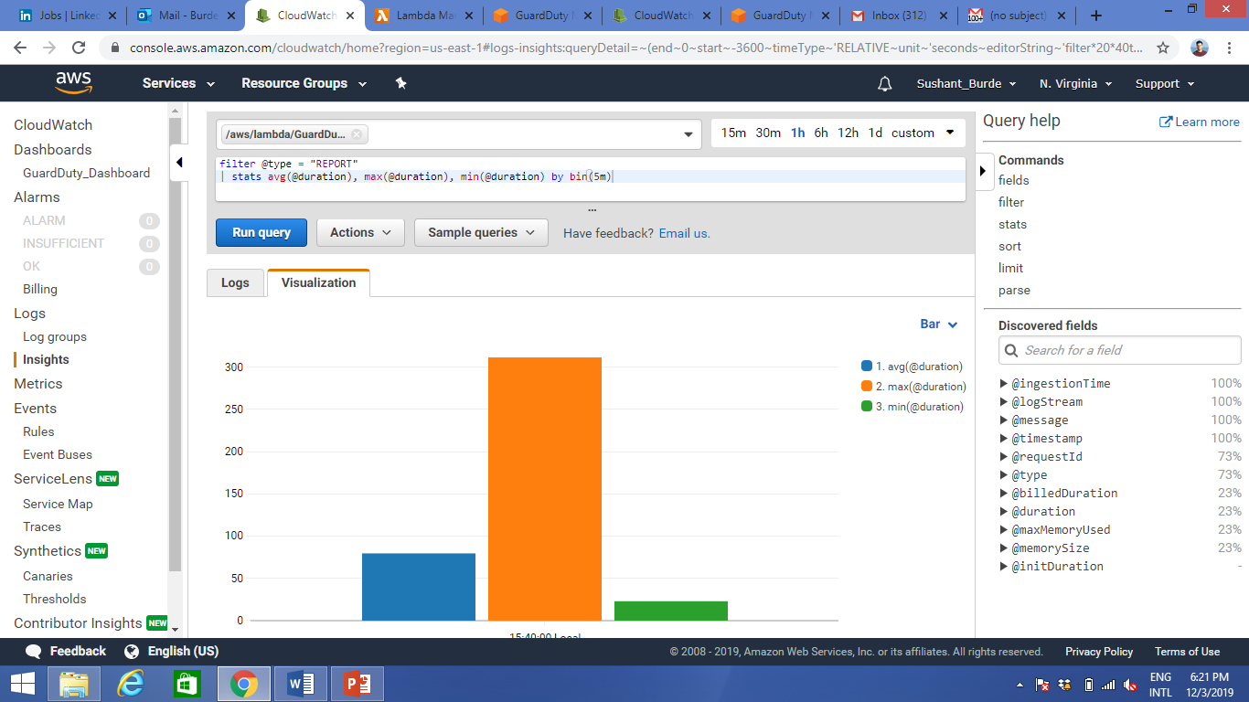

Slide 26
Thankyou!
Any Questions?

